Slide 1
STELLAR OBJECT CLASSIFICATION
Submitted By: MEGHAVANI. S

Slide 2
Agenda
Introduction
Data Preprocessing
Model Development
Model Deployment
Exploratory Data Analysis (EDA)
Data Collection

Slide 3
INTRODUCTION
PROJECT OBJECTIVE:
This project aims to develop machine learning models to classify celestial objects into stars, galaxies, and quasars.
Automated Classification: The models will help efficiently categorize large numbers of celestial objects.
Research Insights: Understanding the key features that distinguish different celestial objects can guide future astronomical research.
Data Processing Optimization: Identifying the most effective classification algorithms can improve data processing pipelines for large-scale astronomical surveys.
Comparative Analysis: A comparative analysis of different machine learning algorithms for the classification task.

Slide 4
DATA COLLECTION

Slide 5
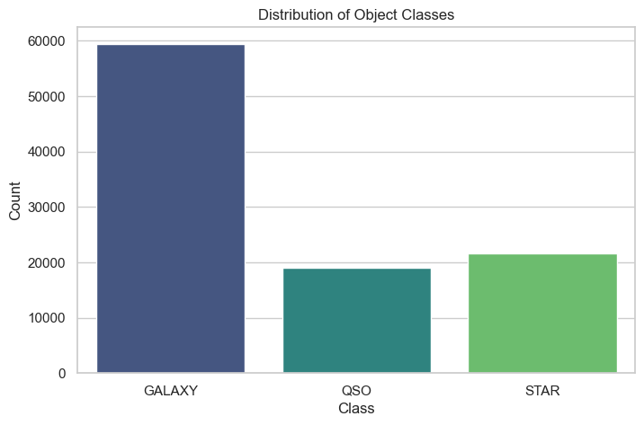
Shape: (10000, 18)
17 Columns are Numerical
1 Column is Categorical
No Null Data Present

Slide 6
FEATURES:
obj_ID : Object Identifier, a unique ID for each object in the CAS image catalog.
alpha : Right Ascension angle
u: Ultraviolet filter in the photometric system
g: Green filter in the photometric system
r: Red filter in the photometric system
i: Near Infrared filter in the photometric system
delta : Declination angle
z: Infrared filter in the photometric system
run_ID: Run Number used to identify the specific scan

Slide 7
rereun_ID: Rerun Number to specify how the image was processed
cam_col: Camera column to identify the scanline within the run
plate: plate ID, identifies each plate in SDSS
MJD: Modified Julian Date, used to indicate when a given piece of SDSS data was taken
fiber_ID: fiber ID that identifies the fiber that pointed the light at the focal plane in each observation
field_ID: Field number to identify each field
spec_obj_ID: Unique ID used for optical spectroscopic objects
class: object class (galaxy, star or quasar object)
redshift: redshift value based on the increase in wavelength

Slide 8
EXPLORATORY DATA ANALYSIS (EDA)

Slide 9
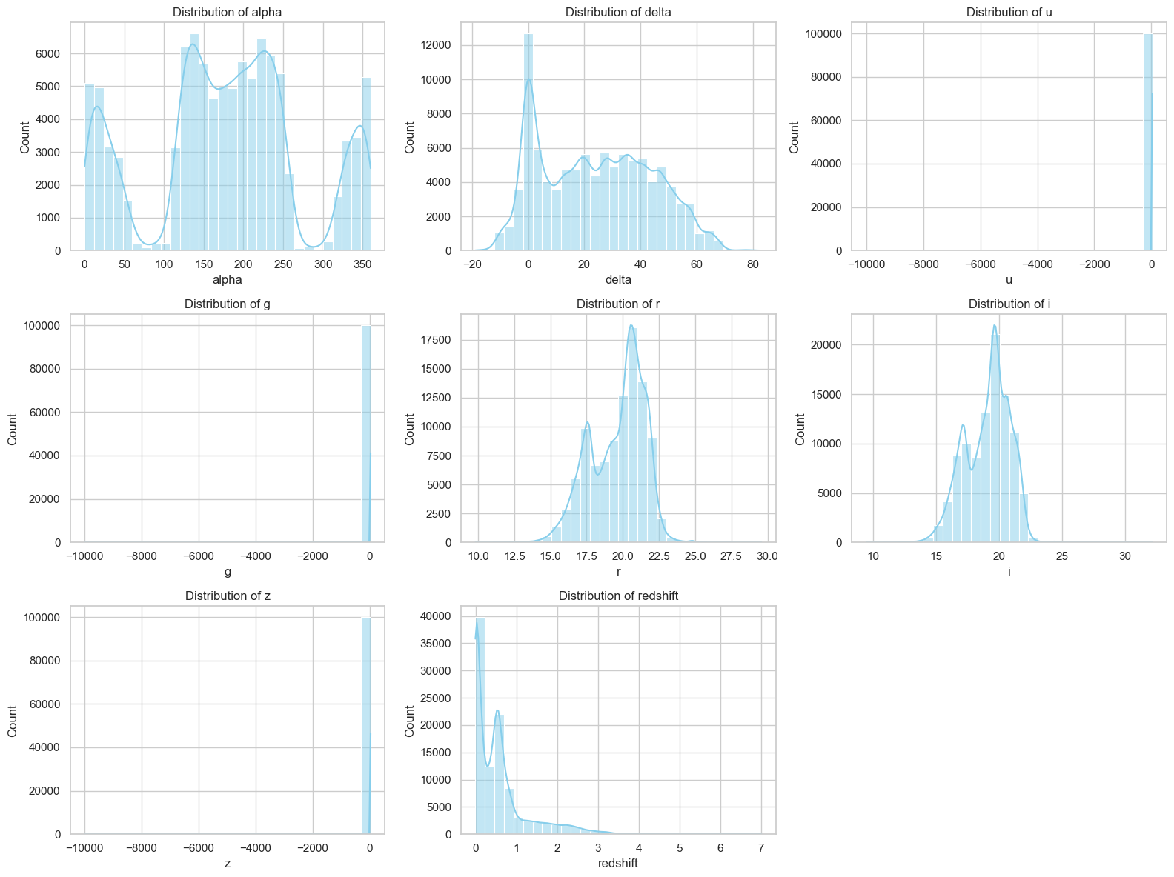
Feature Distributions :

Slide 10
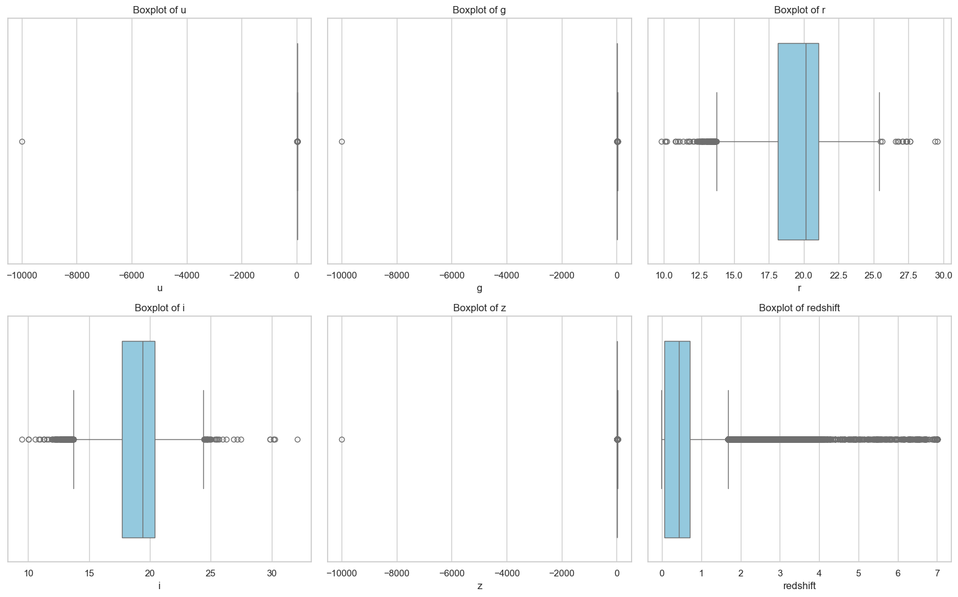
Boxplot Visualization for Outlier Detection:

Slide 11
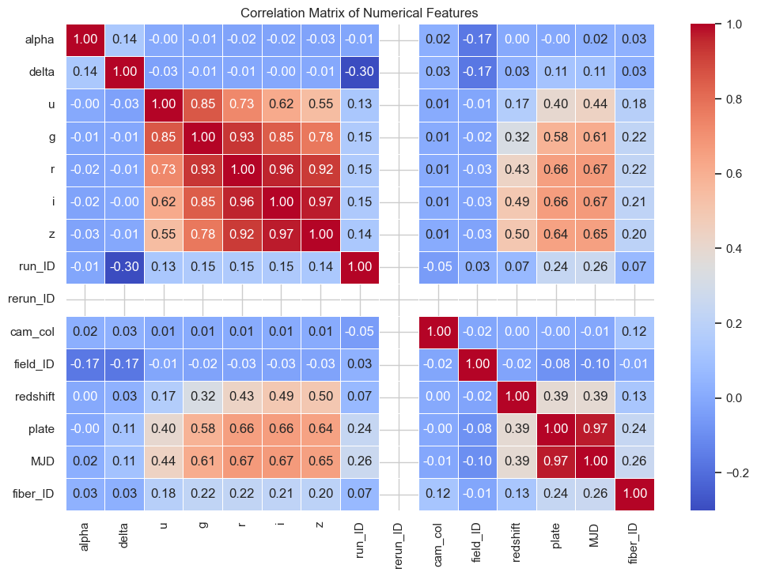
Correlation Matrix + Heatmap:

Slide 12
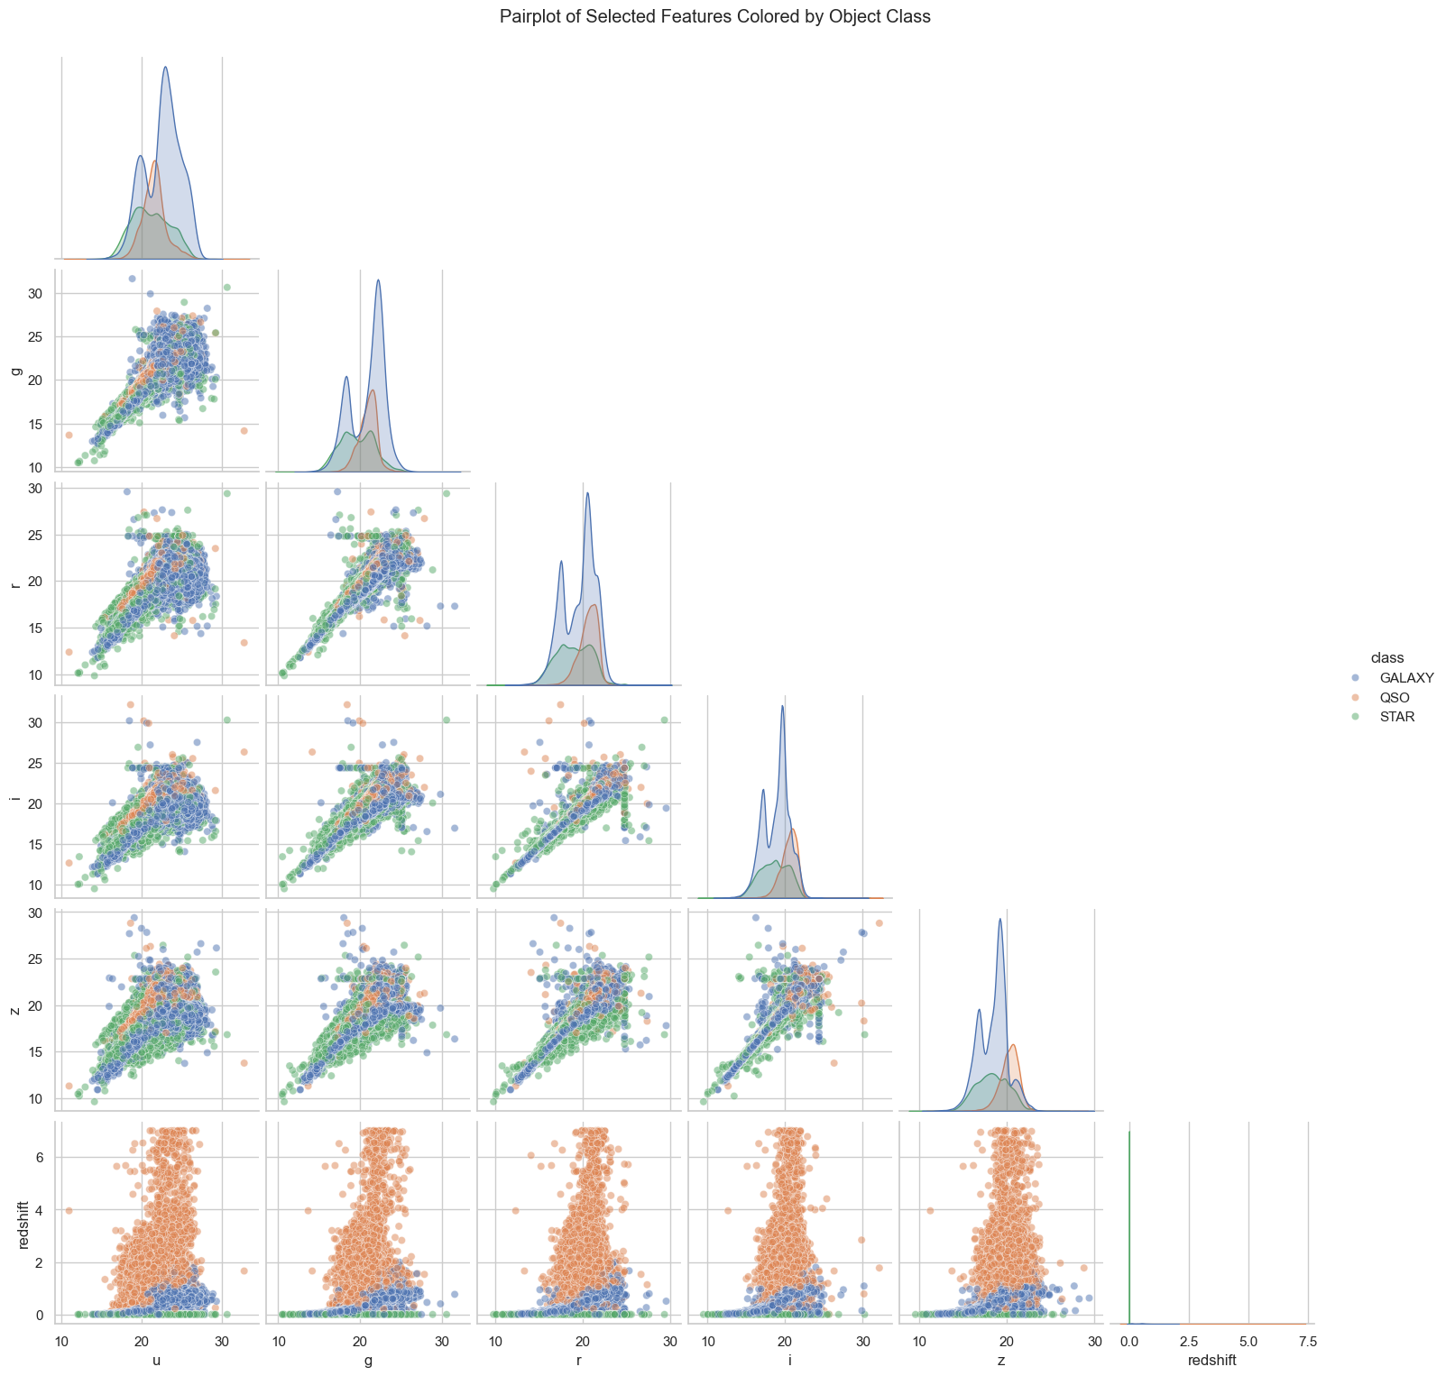
Pairplot for Feature Relationships (Class-Wise):

Slide 13
Data Preprocessing

Slide 14
PREPROCESSING:
Irrelevant Feature Removal : Removed columns not useful for classification (e.g., obj_ID, spec_obj_ID, etc.) to reduce noise and dimensionality.
Feature Engineering : Created new features from existing ones (like color indices ug, gr, ri, iz) which are helpful for classifying celestial objects.
Label Encoding the Target Variable : Converted the target classes (STAR, GALAXY, QSO) into numerical form using Label Encoding for model training.
Feature Scaling : Though not always necessary for tree-based models, applied scaling during comparisons (especially for SVM, KNN).

Slide 15
TRAIN TEST SPLIT
To evaluate machine learning models, we’ll split the dataset into training and testing sets:
Training Set (80%): Used to train the model.
Testing Set (20%): Used to evaluate the model’s performance on unseen data.

Slide 16
Model Selection

Slide 17
MODELS USED:
Decision Tree
Random Forest
K-Nearest Neighbor
SVM
Gradient Boosting
Ada Boost
XG Boost
The dataset is trained with all the above mentioned models and the evaluation metrics are used to check the performance.

Slide 18
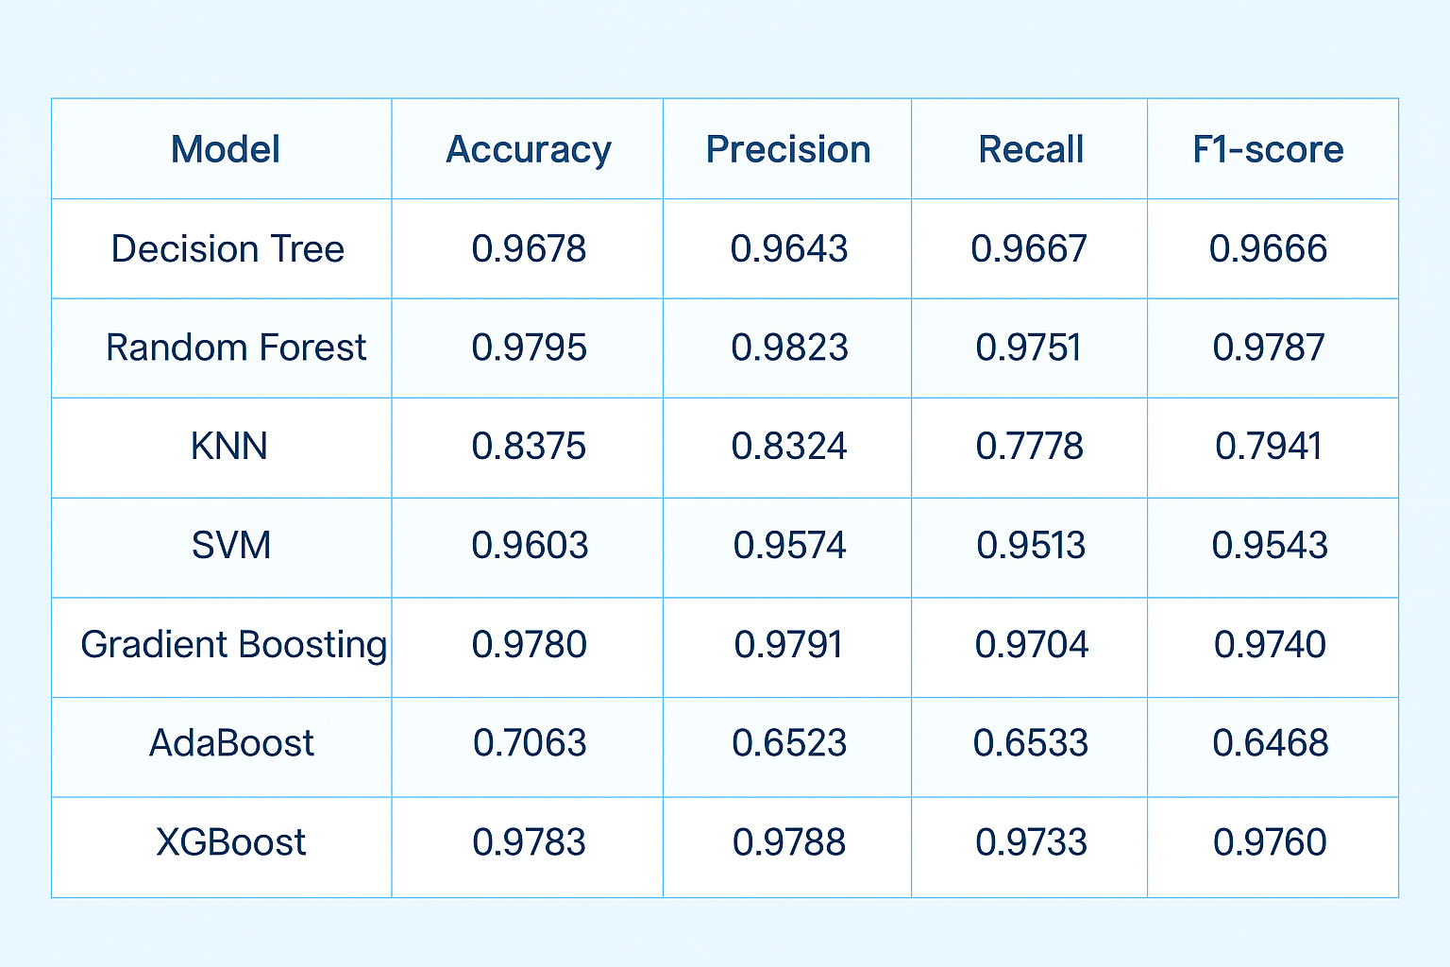
Model Comparison:
Result:
The Random Forest model was selected due to its robust performance, interpretability, and generalization capability across all object class.
It balanced all metrics well and was less affected by outliers or noise compared to other models.

Slide 19
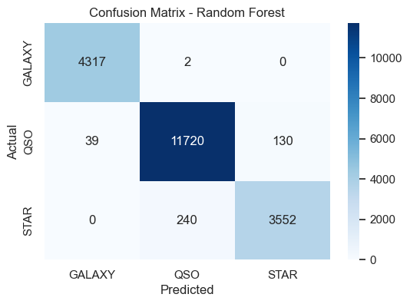
Random Forest Model : Confusion Matrix
GALAXY 4137 correct, only 2 as QSO , 0 as STAR. High precision and recall.
QSO : 11720 correct, 39 as GALAXY, 130 as STAR. Some confusion with STAR and GALAXY.
STAR: 3552 correct, 240 as QSO, 0 as GALAXY. Slight overlap with QSO.
The model shows strong diagonal dominance, indicating high overall accuracy.
Minimal confusion between GALAXY and STAR, suggesting distinct separability in their features.
Most misclassifications occurred between STAR and QSO, likely due to similar spectral properties at certain redshift levels.

Slide 20
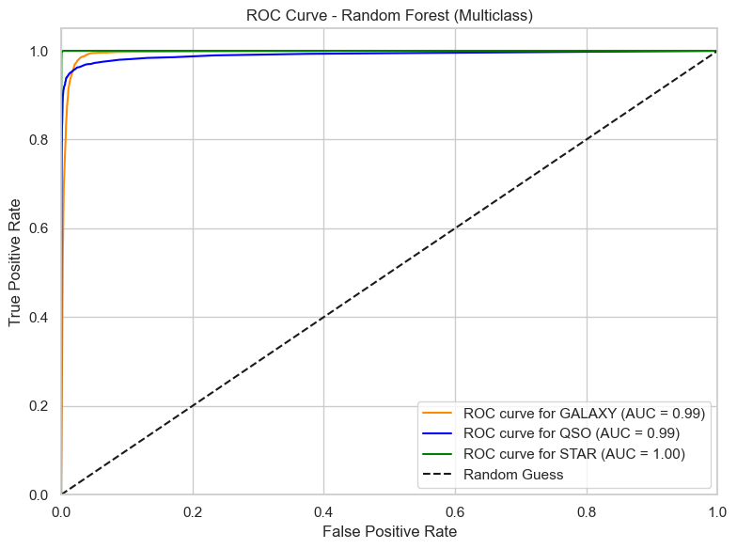
Random Forest Model: ROC Curve
This confirms that Random Forest is top-performing model — high accuracy and excellent discriminative power.

Slide 21

MODEL DEPLOYMENT

Slide 22
Model Deployment : Introduction
Model deployment is the final step of the machine learning pipeline where a trained model is integrated into a real-world application.
In this project, we deployed the Random Forest Classifier using Streamlit, a user-friendly Python framework for building interactive web apps.
The deployed app, titled "Stellar Object Classifier App", allows users to input astronomical features and receive predictions on whether the object is a STAR, GALAXY, or QUASAR—making the model accessible to non-technical users and useful for practical analysis.

Slide 23
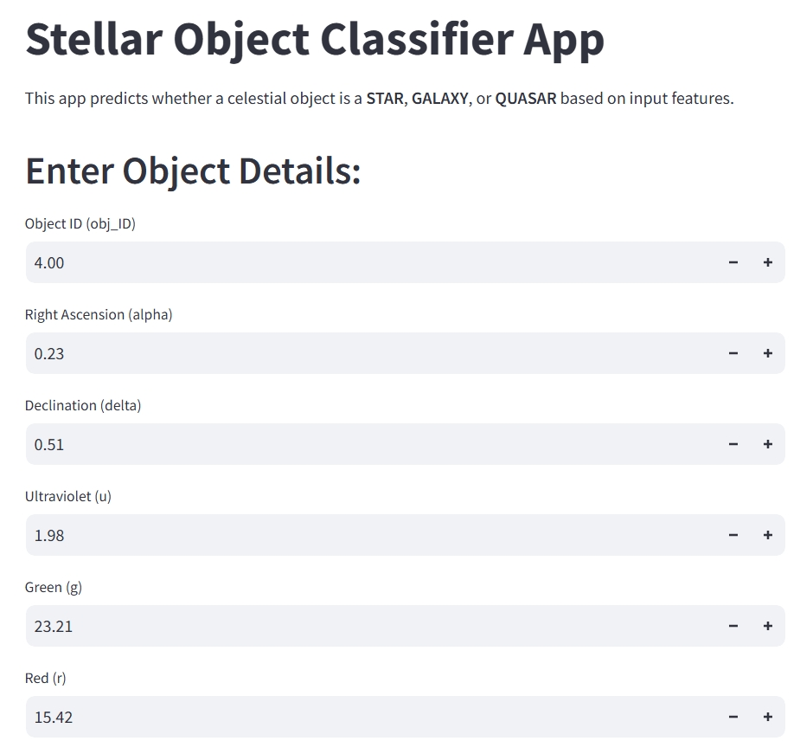
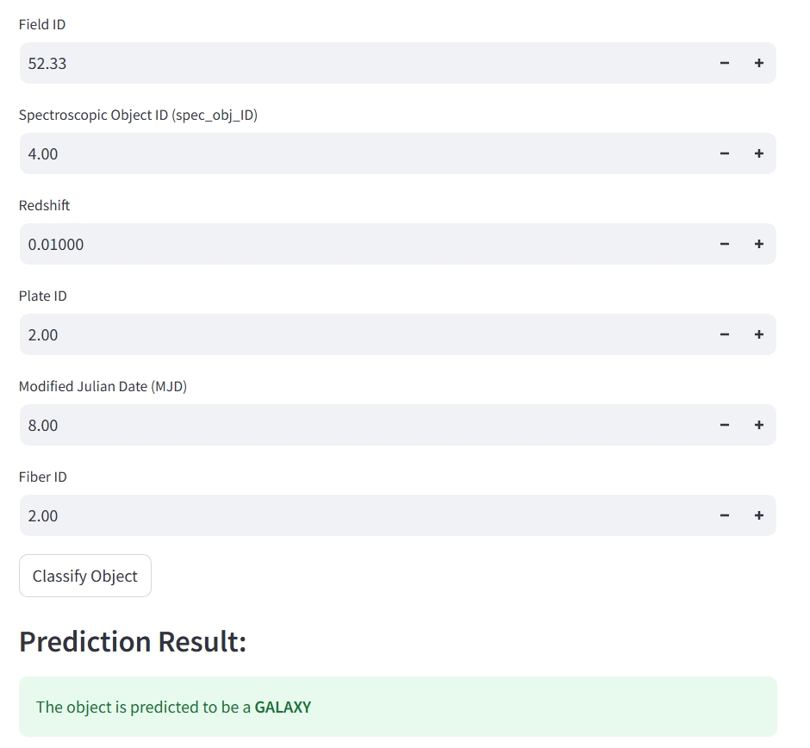
Deployment using Streamlit

Slide 24
CONCLUSION:
This project focused on classifying celestial objects — Stars, Galaxies, and Quasars — using data from the Sloan Digital Sky Survey (SDSS). Starting with a well-structured dataset, we performed Exploratory Data Analysis (EDA) to understand distributions, correlations, and feature importance.
Multiple classification algorithms were trained and evaluated — including Random Forest, SVM, KNN, Decision Trees, and ensemble methods. After careful performance comparison, Random Forest Classifier was selected as the final model due to its high accuracy and robustness to outliers.
The model was then deployed using Streamlit, allowing users to classify stellar objects through a user-friendly web interface.

Slide 25
FUTURE SCOPE:
Integrate deep learning for even better classification performance.
Expand to classify more celestial classes (e.g., nebulae, supernovae).
Integrate with real-time telescope data for live predictions.
Enhance the web app with interactive plots and live sky maps.

Slide 26
Questions ?

Slide 27
Thank You!

